Slide 1
OpenDSS Special Models and Custom Scripting
Roger Dugan Sr. Technical Executive
UCF OpenDSS Workshop July 26-27, 2018 Orlando, FL

Slide 2
Custom Scripting

Slide 3
Custom Simulation Scripting in Snapshot Mode
This is the default solution mode
Attempts one solution for each “solve”
Solves the circuit “as is”
If you want something done, you have to specifically tell it
Set Load and Generator kW, etc.
Load.MyLoad.kW=125
Loadshapes are not used in this mode!
Sample Monitors and meters
Solve
Sample

Slide 4
Custom Simulation Scripting in “Time” Mode
Similar to Snapshot mode EXCEPT:
Loads, Generators can follow a selected Loadshape
Duty, Daily, or Yearly
Monitors are automatically sampled
But not Energymeters; do that explicitly if desired
Time is automatically incremented AFTER solve

Slide 5
Snapshot Mode Scripting Example
Set Gen kW explicitly each time step
! Start the ramp down at 1 sec
Set sec=1
Generator.PV1.kW=(2500 250 -)
Solve
Sample
Set sec=2
Generator.PV1.kW=(2500 500 -)
Solve
Sample
Set sec = 2.020834372 ! Unit 1
storage.jo0235001304.state=discharging %discharge=11.9
Solve
Sample
Set sec = 2.022028115 ! Unit 2
storage.jo0235000257.state=discharging %discharge=11.9
Solve
Sample
Set sec = 2.023158858 ! Unit 3
storage.jo0235000265.state=discharging %discharge=11.9
Solve
Sample
Set sec = 2.024604602 ! Unit 4
storage.jo0235000268_1.state=discharging %discharge=11.9
Solve
Sample
Set sec = 2.025738325 ! Unit 5
storage.jo0235000268_2.dispmode=discharging %discharge=11.9
Solve
Sample
Etc.
Solve and Sample explicitly at each step
Set each Storage unit discharge rate explicitly each time step
(time is used for recording purposes only)

Slide 6
Time Mode Scripting Example
All Loads, Generators will follow assigned Duty cycle loadshape
! Start the ramp down at 1 sec
Set mode=time loadshapeclass=duty
set stepsize=1s
Solve ! Base case t=0
Solve ! t=t+1 = 2
Solve ! t=2 second solution; t=t+1 = 3
Set sec = 2.020834372 ! Unit 1 (reset t)
storage.jo0235001304.state=discharging %discharge=11.9
Solve
Set sec = 2.022028115 ! Unit 2
storage.jo0235000257.state=discharging %discharge=11.9
Solve
Set sec = 2.023158858 ! Unit 3
storage.jo0235000265.state=discharging %discharge=11.9
Solve
Set sec = 2.024604602 ! Unit 4
storage.jo0235000268_1.state=discharging %discharge=11.9
Solve
Set sec = 2.025738325 ! Unit 5
storage.jo0235000268_2.dispmode=discharging %discharge=11.9
Solve
Etc.
Set sec=3
Solve ! t=3 solution; t=t+1 = 4
….

Slide 7
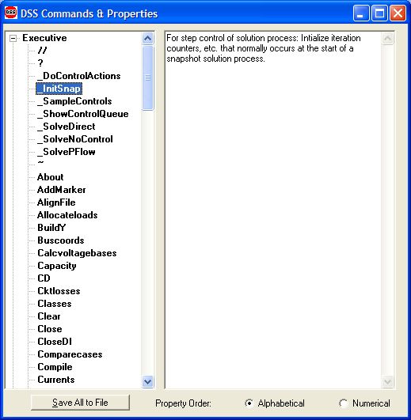
Custom Simulation Scripting: Rolling Your Own Solution Algorithm
These commands allow step-by-step control of the solution process

Slide 8
Custom Simulation Scripting: Rolling Your Own Solution Algorithm
The basic Snapshot solution process:
Initialize Snapshot (_InitSnap)
Repeat until converged:
Solve Circuit (_SolveNoControl)
Sample control devices (_SampleControls)
Do control actions, if any (_DoControlActions)
You may wish, for example, to interject custom control actions after the _SolveNoControl step

Slide 9
Custom Simulation Scripting, cont’d
Via COM interface
Whatever you want (if you can write code)
See Examples Folder on Sourceforge site
Excel: SampleDSSDriver.xls
Matlab:
VoltageProfileExample.m
DSSMonteCarlo.m

Slide 10
For More Information …
See “OpenDSS Custom Scripting.Doc”
(Sourceforge site and “Doc” Folder)

Slide 11
Modeling Solar PV

Slide 12
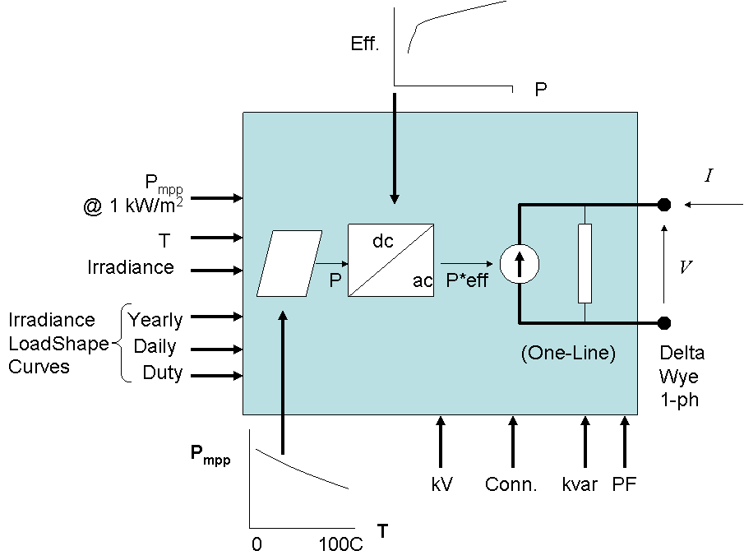
PVSystem in the OpenDSS
The PVSystem model combines a model of the PV array and the PV inverter into one convenient model to use for distribution system impacts studies

Slide 13
Example Script
This example defines a PV system with a panel Pmpp of 500 kW at 1 kW/m² irradiance and a panel temperature of 25°C. The inverter is rated at 500 kVA. A PF of 1.0 is assumed for this example.
Can also be used with the InvControl control object that implements advanced (‘smart’) inverter functions such as volt-var, volt-watt, and dynamic reactive current.
InvControl usage to be covered later today

Slide 14
Example Script
clear
New Circuit.PVSystem basekv=12.47 Isc3=1000 Isc1=900
// P-T curve is per unit of rated Pmpp vs temperature
// This one is for a Pmpp stated at 25 deg
New XYCurve.MyPvsT npts=4 xarray=[0 25 75 100] yarray=[1.2 1.0 0.8 0.6]
// efficiency curve is per unit eff vs per unit power
New XYCurve.MyEff npts=4 xarray=[.1 .2 .4 1.0] yarray=[.86 .9 .93 .97]
// per unit irradiance curve (per unit if "irradiance" property)
New Loadshape.MyIrrad npts=24 interval=1 mult=[0 0 0 0 0 0 .1 .2 .3 .5 .8 .9 1.0 1.0 .99 .9 .7 .4 .1 0 0 0 0 0]
// 24-hr temp shape curve
New Tshape.MyTemp npts=24 interval=1 temp=[25, 25, 25, 25, 25, 25, 25, 25, 35, 40, 45, 50 60 60 55 40 35 30 25 25 25 25 25 25]
// **** plot tshape object=mytemp
// take the default line
New Line.line1 Bus1=sourcebus bus2=PVbus Length=2

Slide 15
Example Script (cont’d)
! PV definition
New PVSystem.PV phases=3 bus1=PVbus kV=12.47 kVA=500 irrad=0.8 Pmpp=500
~ temperature=25 PF=1 effcurve=Myeff P-TCurve=MyPvsT
~ Daily=MyIrrad TDaily=MyTemp
set voltagebases=[12.47]
calcv
solve ! solves at the specified irradiance and temperature
new monitor.m1 PVSystem.PV 1 mode=1 ppolar=no
new monitor.m2 PVSystem.PV 1
solve
solve mode=daily
show mon m1
show mon m2

Slide 16
Example Script (cont’d)
Export monitors m1
Plot monitor object= m1 channels=(1 )
Export monitors m2
Plot monitor object= m2 channels=(1 ) base=[7200]
Export monitors m2
Plot monitor object= m2 channels=(9 )

Slide 17
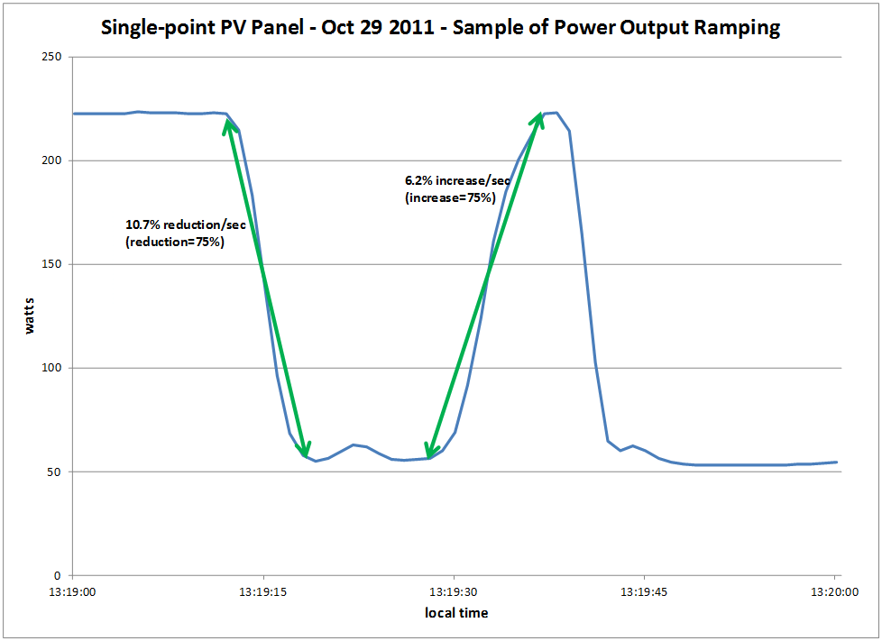
Modeling PV Systems – Variability/Ramping – Single-Panel

Slide 18
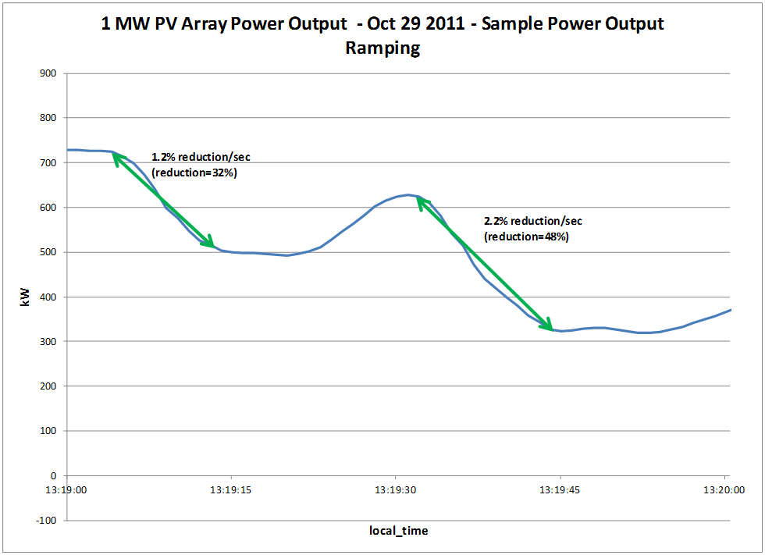
Modeling PV Systems – Variability/Ramping – 1 MW PV Array (same location as Single-Panel)

Slide 19
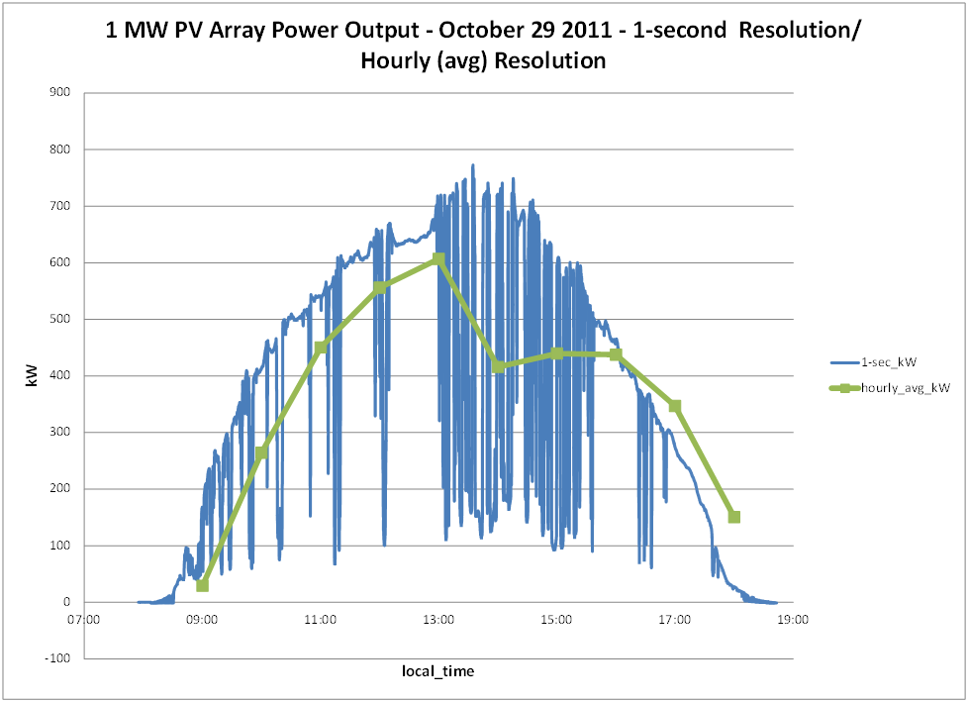
Modeling PV Systems – Variability/Ramping – Significance of Solar Irradiance Resolution

Slide 20
Modeling PV Systems for Distribution System Impact Assessment – Fault Response
Fault current contribution
Conservative Rule-of-thumb: 2 x Full Output Rating of Inverter for 1 cycle (three-phase fault)
Other testing has been performed by Southern California Edison, NREL, PV inverter manufacturers, etc
Inverters generally shut down at 1.2 pu of rated current
May be 3-4 times pre-fault current
Irregular behavior on voltage sags
Tries to hold constant power (current increases)
May become discontinuous

Slide 21
‘Smart’ Inverter Control in the OpenDSS

Slide 22
InvControl Control Object
Works in conjunction with PVSystem object(s) to control the PVSystem(s) output according to ‘smart’ inverter functions
Three modes currently available:
Volt-var
Follows a voltage versus reactive power curve and changes the reactive power generation (capacitive) or reactive power absorption (inductive) according to the terminal voltage at each PVSystem
Volt-watt
Follows a voltage versus active power curve and changes the active power output according to the terminal voltage at each PVSystem (within the limits of the present irradiance)
Dynamic Reactive Current (DRC)
Has several settings that change the reactive power generation or absorption in response to fast changes in terminal voltage (e.g., during a sag or swell)

Slide 23
Volt-var Control Mode – Example Volt-var Curve

Slide 24
InvControl in Volt-var Mode – Script
New PVSystem.3P_ExistingSite4 phases=3 bus1=B51854_sec kV=0.4157 kVA=523 ~ irradiance=1 Pmpp=475 pf=1 %cutin=0.1 %cutout=0.1 yearly=PV_ls
New PVSystem.3P_ExistingSite1 phases=3 bus1=X_5865228330A kV=0.4157 kVA=314 ~ irradiance=1 Pmpp=285 pf=1 %cutin=0.1 %cutout=0.1 yearly=PV_ls
New PVSystem.3P_ExistingSite3 phases=3 bus1=X_5891328219_Cust1 kV=0.4157 ~ kVA=836 irradiance=1 Pmpp=760 pf=1 %cutin=0.1 %cutout=0.1 yearly=PV_ls
New PVSystem.3P_ExistingSite2 phases=3 bus1=B4832_sec kV=0.4157 kVA=209 ~ irradiance=1 Pmpp=190 pf=1 %cutin=0.1 %cutout=0.1 yearly=PV_ls
New XYCurve.vv_curve npts=4 Yarray=(1.0,1.0,-1.0,-1.0) ~ XArray=(0.5,0.95,1.05,1.5)
New InvControl.InvPVCtrl mode=VOLTVAR voltage_curvex_ref=rated ~ vvc_curve1=vv_curve EventLog=yes

Slide 25
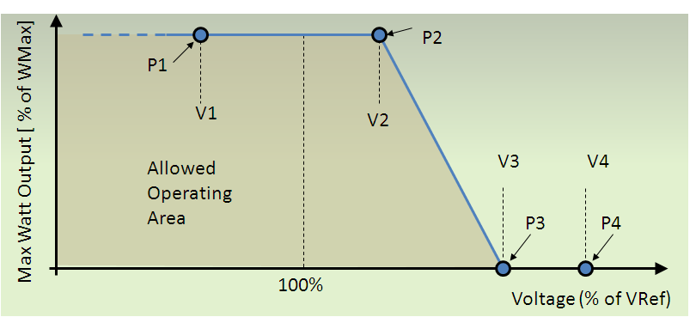
Volt-watt Control Mode – Example Volt-watt Curve

Slide 26
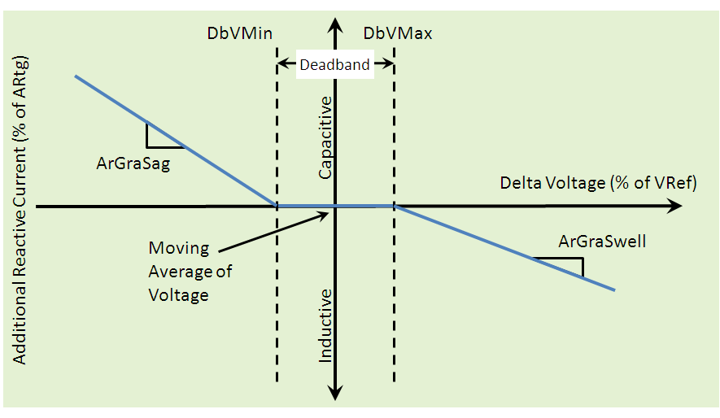
DRC Control Mode – Settings Curve

Slide 27
Including Storage in Distribution Planning
OpenDSS STORAGE and STORAGECONTROLLER objects

Slide 28
Introduction
Storage is the frequently-proposed solution to renewable generation issues
States and provinces are requiring large amounts of storage
(Cal: 1.3 GW by 2020; 425 MW on distribution)
Significant amounts expected on Distribution systems controlled for benefit of Transmission

Slide 29
Introduction, cont’d
Distribution planners are accustomed to static power flow calculations
Accurate analysis of storage required sequential-time simulation (“QSTS”)
Summary of EPRI research into modeling energy storage for planning …

Slide 30
Applications of Storage on Distribution
Smoothing solar PV power output
Extending solar PV output into the evening
Support of the Transmission grid
Extending capacity of existing assets
Supporting alternate feeds during reconfig.
Controlling frequency of a microgrid
Increasing short circuit strength of a microgrid

Slide 31
Planning Issues Introduced by Storage
Overvoltages while discharging
Low voltages while charging
Voltage regulation while compensating for transmission grid support
Interference with overcurrent protection scheme
Insufficient short-circuit capacity in microgrid

Slide 32
Sequential-Time Simulation
All DER disrupt the normal load shape
A single static power flow does not give a good answer
Have to simulate over a significant time period
Sequential-time power flow is now accepted practice in advanced distribution planning

Slide 33
The Planning Problem with Storage is More than Capacity to meet Demand
Storage is a variable resource but it is also Limited
Planning tools must account for energy stored
Has a limited ramp rate
Has to be recharged at some other time
Has losses
Charge-discharge cycle (~15-20%)
Idling losses (temperature dependent)

Slide 34
6 Simulation Modes Have Been Identified and Implemented in OpenDSS Program
Static (charge or discharge at specific rate)
Time (charge or discharge at specific time)
Peak Shave
Load Following
Loadshape Following (define a loadshape)
Dynamics (i.e., electromechanical transients)

Slide 35
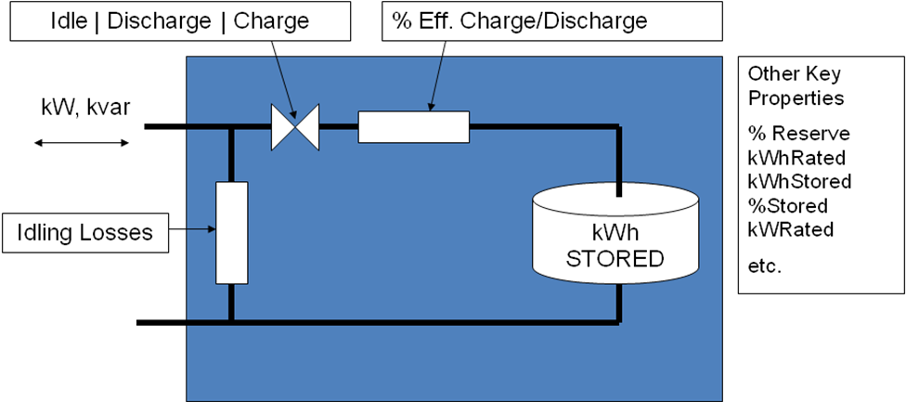
EPRI’s OpenDSS Employs a Generic Energy Storage Element

Slide 36
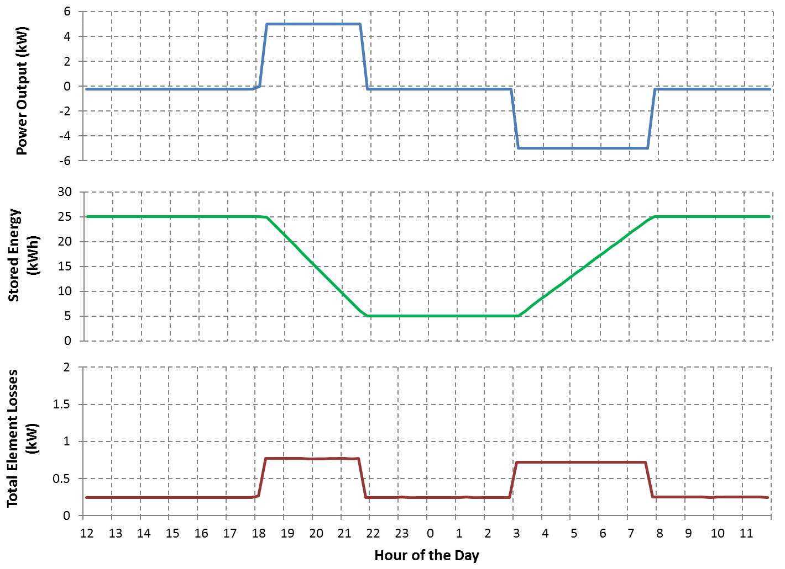
Storage Element Operation

Slide 37
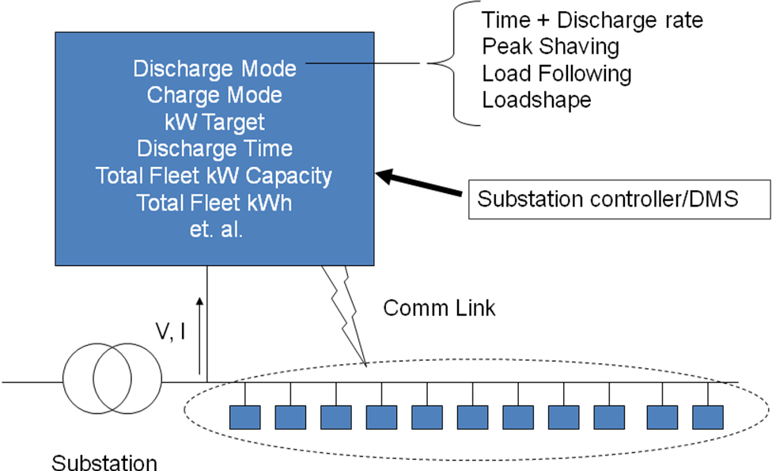
Storage Controller Model
Fleet of Distributed Energy Storage Elements

Slide 38
Peak Shaving Applications
Time step size: 15-60 min

Slide 39
Compensating for Renewable Generation
Extend solar PV output into evening peak.

Slide 40
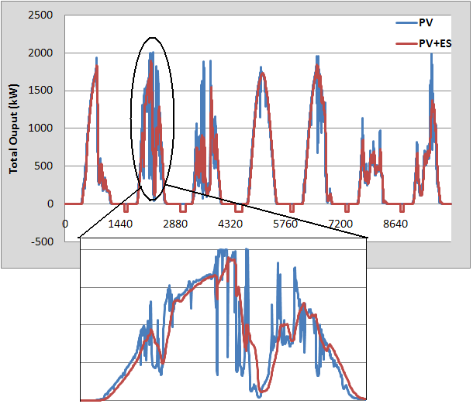
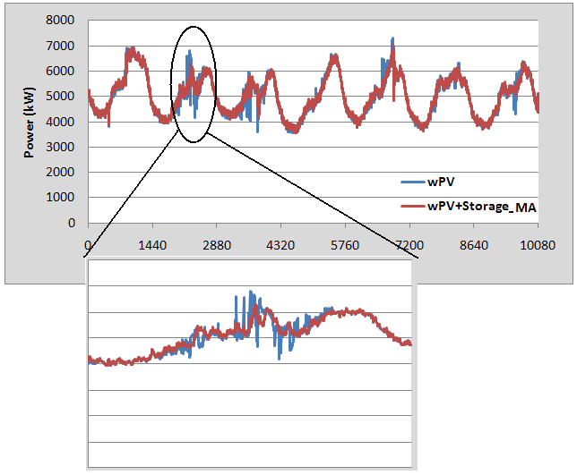
Intermittent Generation Smoothing
Network Response
PV Output

Slide 41
Storage Power Output for Smoothing

Slide 42
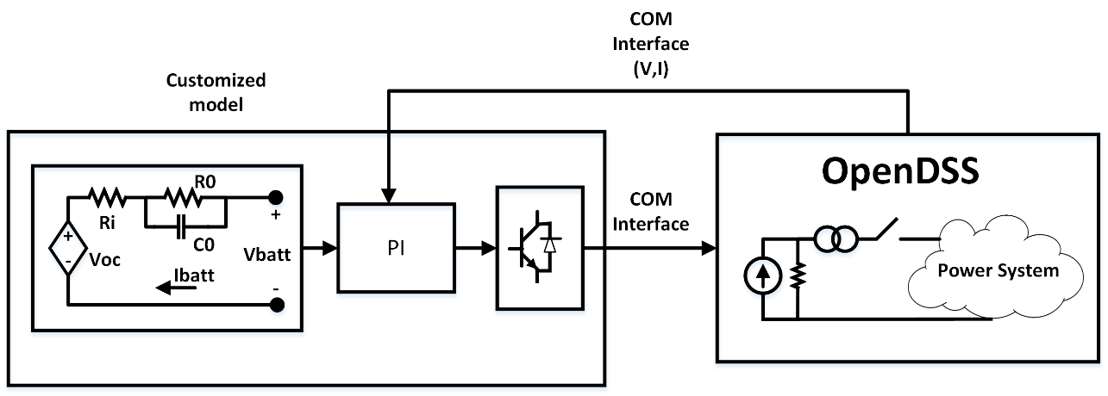
A Dynamics Example (Black start of a Microgrid)
Model may require more than 30 parameters.

Slide 43
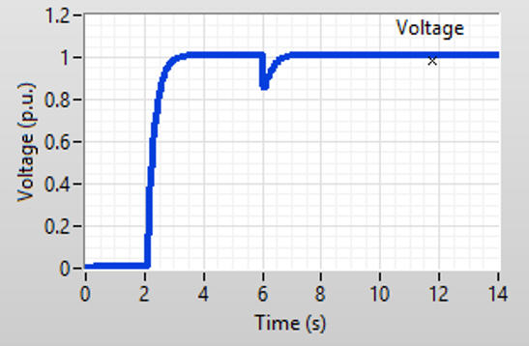
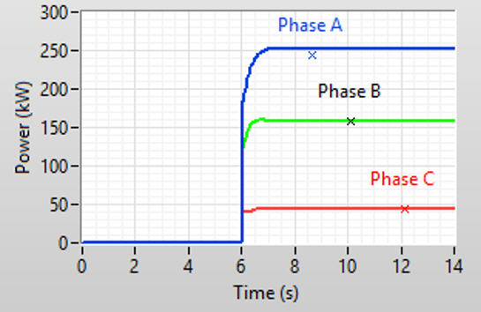
Results from the Model

Slide 44
How to Support Vendor-Supplied Models for Complex Storage System Models
Establish common software interface (DLL?)
Variants for QSTS, Dynamics, and EMT
Windows dominant platform in US for distribution
DSA vendors will have to support
Storage system vendors will want protection

Slide 45
Simplified Distribution Planning
System Performance Considerations
Overvoltages while discharging
Low voltages when charging
Voltage regulation interaction (bulk system dispatch)
Interference with overcurrent protection
Short circuit capacity when islanded
At least two accommodation screens:
Max output / min load
Max charge / max load

Slide 46
Writing DLLs

Slide 47
OpenDSS Currently Supporting User DLLs
Generator
Ex.: IndMach012a.DLL (Now also built-in model)
Storage
User model
DynaDLL (Dynamics only)
PVSystem
CapControl
Custom capacitor control

Slide 48
Typical Call to User-Written DLL (PVSystem)
PROCEDURE TPVsystemObj.DoUserModel;
{Compute total terminal Current from User-written model}
VAR
i : Integer;
Begin
CalcYPrimContribution(InjCurrent); // Init InjCurrent Array
If UserModel.Exists // Check automatically selects the usermodel If true
Then Begin
UserModel.FCalc (Vterminal, Iterminal);
IterminalUpdated := TRUE;
With ActiveCircuit.Solution
Do Begin // Negate currents from user model for power flow PVSystem element model
FOR i := 1 to FnConds Do Caccum(InjCurrent^[i], Cnegate(Iterminal^[i]));
End;
End
Else DoSimpleMsg('PVSystem.' + name + ' model designated to use user-written model, but user-written model is not defined.', 567);
End;

Slide 49
Example: Storage DynaDLL Call
procedure TStorageObj.DoDynaModel;
Var
DESSCurr: Array[1..6] of Complex; // Temporary biffer
i :Integer;
begin
// do user written dynamics model
With ActiveCircuit.Solution Do
Begin // Just pass node voltages to ground and let dynamic model take care of it
For i := 1 to FNconds Do VTerminal^[i] := NodeV^[NodeRef^[i]];
StorageVars.w_grid := TwoPi * Frequency;
End;
DynaModel.FCalc(Vterminal, @DESSCurr);
CalcYPrimContribution(InjCurrent); // Init InjCurrent Array
ZeroITerminal;
For i := 1 to Fnphases Do
Begin
StickCurrInTerminalArray(ITerminal, Cnegate(DESSCurr[i]), i); // Put into Terminal array taking into account connection
IterminalUpdated := TRUE;
StickCurrInTerminalArray(InjCurrent, DESSCurr[i], i); // Put into Terminal array taking into account connection
End;
end;

Slide 50
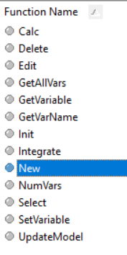
Exported Functions of a Storage Model DynaDLL

Slide 51
Code for Loading Storage DynaDLL
procedure TStoreDynaModel.Set_Name(const Value:String);
begin
<SNIP>
FHandle := LoadLibrary(PChar(Value)); // Default LoadLibrary and PChar must agree in expected type
IF FHandle = 0 Then
Begin
// Try again with full path name
FHandle := LoadLibrary(PChar(DSSDirectory + Value));
End;
<SNIP>
Begin
FName := Value;
// Now set up all the procedure variables
FuncError := False;
@Fnew := CheckFuncError(GetProcAddress(FHandle, 'New'), 'New');
If not FuncError Then @FSelect := CheckFuncError(GetProcAddress(FHandle, 'Select'), 'Select');
If not FuncError Then @FInit := CheckFuncError(GetProcAddress(FHandle, 'Init'), 'Init');
If not FuncError Then @FCalc := CheckFuncError(GetProcAddress(FHandle, 'Calc'), 'Calc');
If not FuncError Then @FIntegrate := CheckFuncError(GetProcAddress(FHandle, 'Integrate'), 'Integrate');
If not FuncError Then @FEdit := CheckFuncError(GetProcAddress(FHandle, 'Edit'), 'Edit');
If not FuncError Then @FUpdateModel := CheckFuncError(GetProcAddress(FHandle, 'UpdateModel'), 'UpdateModel');
If not FuncError Then @FDelete := CheckFuncError(GetProcAddress(FHandle, 'Delete'), 'Delete');
If not FuncError Then @FNumVars := CheckFuncError(GetProcAddress(FHandle, 'NumVars'), 'NumVars');
If not FuncError Then @FGetAllVars := CheckFuncError(GetProcAddress(FHandle, 'GetAllVars'), 'GetAllVars');
If not FuncError Then @FGetVariable := CheckFuncError(GetProcAddress(FHandle, 'GetVariable'), 'GetVariable');
If not FuncError Then @FSetVariable := CheckFuncError(GetProcAddress(FHandle, 'SetVariable'), 'SetVariable');
If not FuncError Then @FGetVarName := CheckFuncError(GetProcAddress(FHandle, 'GetVarName'), 'GetVarName');
<SNIP>
Else Begin
FID := FNew( ActiveCircuit.Solution.Dynavars, CallBackRoutines); // Create new instance of user model
End;;
End;
end;
Load the DLL
Get addresses of DLL function

Slide 52
{Note: everything is passed by reference (as a pointer), so it is possible to change the values in
the structures (imported in Dynamics) in the main program. This is dangerous so be careful.}
Function New(Var GenVars:TGeneratorVars; Var DynaData:TDynamicsRec; Var CallBacks:TDSSCallBacks): Integer; Stdcall; // Make a new instance
Procedure Delete(var ID:Integer); Stdcall; // deletes specified instance
Function Select(var ID:Integer):Integer; Stdcall; // Select active instance
Procedure Init(V, I:pComplexArray);Stdcall;
{Initialize model. Called when entering Dynamics mode.
V,I should contain results of most recent power flow solution.}
Procedure Calc(V, I:pComplexArray); stdcall;
{Main routine for performing the model calculations. For "usermodel", this
function basically computes I given V. For "shaftmodel", uses V and I
to calculate Pshaft, speed, etc. in dynamic data structures}
Procedure Integrate; stdcall; // Integrates any state vars
{Called to integrate state variables. User model is responsible for its own
integration. Check IterationFlag to determine if this
is a predictor or corrector step }
Procedure Edit(s:pAnsichar; Maxlen:Cardinal); Stdcall;
{called when DSS encounters user-supplied data string. This module
is reponsible for interpreting whatever format this user-written modeli
is designed for.}
Procedure UpdateModel; StdCall;
{This is called when DSS needs to update the data that is computed
from user-supplied data forms. }
Procedure Save; Stdcall;
{Save the model to a file (of the programmer's choice) so that the state
data, if any can be restored for a restart.}
Procedure Restore; Stdcall;
{Reverse the Save command}
{The user may return a number of double-precision values for monitoring}
Function NumVars:Integer;Stdcall; // Number of variables that can be returned for monitoring
Procedure GetAllVars(Vars:pDoubleArray);StdCall;
{Called by DSS monitoring elements. Returns values of all monitoring variables in
an array of doubles. The DSS will allocate "Vars" to the appropriate size. This
routine will use Vars as a pointer to the array.}
Function GetVariable(var i:Integer):double;StdCall; // returns a i-th variable value only
Procedure SetVariable(var i:Integer;var value:Double); StdCall;
{DSS allows users to set variables of user-written models directly.
Whatever variables that are exposed can be set if this routine handles it}
Procedure GetVarName(var VarNum:Integer; VarName:pAnsiChar; maxlen:Cardinal); StdCall;
{Returns name of a specific variable as a pointer to a string.
Set VarName= pointer to the first character in a null-terminated string}
Interface Code to IndMach012a.dll

Slide 53
CallBacks –Hooks into OpenDSS for DLLs (Partial)
DoDSSCommand: Procedure(S : pAnsiChar; Maxlen : Cardinal); StdCall;
GetActiveElementBusNames: Procedure(Name1 : pAnsiChar; Len1 : Cardinal; Name2 : pAnsiChar; Len2 : Cardinal); StdCall;
GetActiveElementVoltages: Procedure(Var NumVoltages : Integer; V : pComplexArray); StdCall;
GetActiveElementCurrents: Procedure(Var NumCurrents : Integer; Curr : pComplexArray); StdCall;
GetActiveElementLosses: Procedure(Var TotalLosses, LoadLosses, NoLoadLosses : Complex); StdCall;
GetActiveElementPower: Procedure(Terminal : Integer; Var TotalPower : Complex); StdCall;
GetActiveElementNumCust: Procedure(Var NumCust, TotalCust : Integer); StdCall;
GetActiveElementNodeRef: Procedure(Maxsize : Integer; NodeReferenceArray : pIntegerArray); StdCall;// calling program must allocate
GetActiveElementBusRef: Function(Terminal : Integer) : Integer; StdCall;
GetActiveElementTerminalInfo: Procedure(Var NumTerminals, NumConds, NumPhases : Integer); StdCall;
GetPtrToSystemVarray: Procedure(var V : Pointer; var iNumNodes : Integer); StdCall; // Returns pointer to Solution.V and size
GetActiveElementIndex: Function() : Integer; StdCall;
IsActiveElementEnabled: Function() : Boolean; StdCall;
IsBusCoordinateDefined: Function(BusRef : Integer) : Boolean; StdCall;
GetBusCoordinate: Procedure(BusRef : Integer; Var X, Y : Double); StdCall;
GetBuskVBase: Function(BusRef : Integer) : Double; StdCall;
GetBusDistFromMeter: Function(BusRef : Integer) : Double; StdCall;
GetDynamicsStruct: Procedure(var pDynamicsStruct : Pointer); StdCall; // Returns pointer to dynamics variables structure
GetStepSize: Function() : Double; StdCall; // Return just 'h' from dynamics record
GetTimeSec: Function() : Double; StdCall; // returns t in sec from top of hour
GetTimeHr: Function() : Double; StdCall; // returns time as a double in hours
GetPublicDataPtr: Procedure(var pPublicData : Pointer; Var PublicDataBytes : Integer); StdCall;
GetActiveElementName: Function(FullName : pAnsiChar; MaxNameLen : Cardinal) : Integer; StdCall;
GetActiveElementPtr: Function() : Pointer; StdCall; // Returns pointer to active circuit element
ControlQueuePush: Function(Const Hour:Integer; Const Sec:Double; Const Code, ProxyHdl:Integer; Owner:Pointer):Integer; StdCall;
GetResultStr: Procedure(S : pAnsiChar; Maxlen : Cardinal); StdCall;

